Slide 1

Chapter 13
Inner Classes
Slides prepared by Rose Williams, Binghamton University
Kenrick Mock, University of Alaska Anchorage

Slide 2
Simple Uses of Inner Classes
Inner classes are classes defined within other classes
The class that includes the inner class is called the outer class
There is no particular location where the definition of the inner class (or classes) must be place within the outer class
Placing it first or last, however, will guarantee that it is easy to find

Slide 3
Simple Uses of Inner Classes
An inner class definition is a member of the outer class in the same way that the instance variables and methods of the outer class are members
An inner class is local to the outer class definition
The name of an inner class may be reused for something else outside the outer class definition
If the inner class is private, then the inner class cannot be accessed by name outside the definition of the outer class

Slide 4
Simple Uses of Inner Classes
There are two main advantages to inner classes
They can make the outer class more self-contained since they are defined inside a class
Both of their methods have access to each other's private methods and instance variables
Using an inner class as a helping class is one of the most useful applications of inner classes
If used as a helping class, an inner class should be marked private

Slide 5
Tip: Inner and Outer Classes Have Access to Each Other's Private Members
Within the definition of a method of an inner class:
It is legal to reference a private instance variable of the outer class
It is legal to invoke a private method of the outer class
Within the definition of a method of the outer class
It is legal to reference a private instance variable of the inner class on an object of the inner class
It is legal to invoke a (nonstatic) method of the inner class as long as an object of the inner class is used as a calling object
Within the definition of the inner or outer classes, the modifiers public and private are equivalent

Slide 6
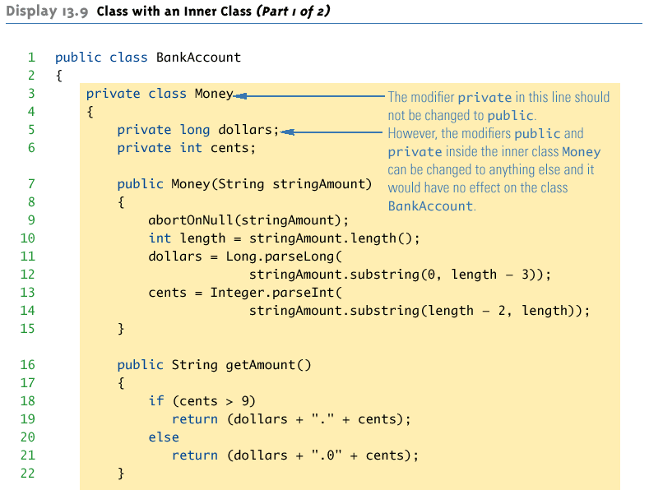
Class with an Inner Class

Slide 7
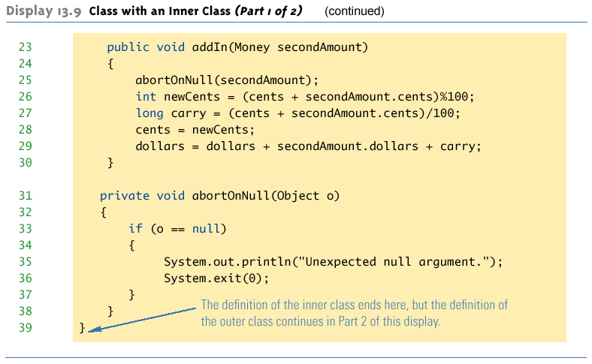
Class with an Inner Class

Slide 8
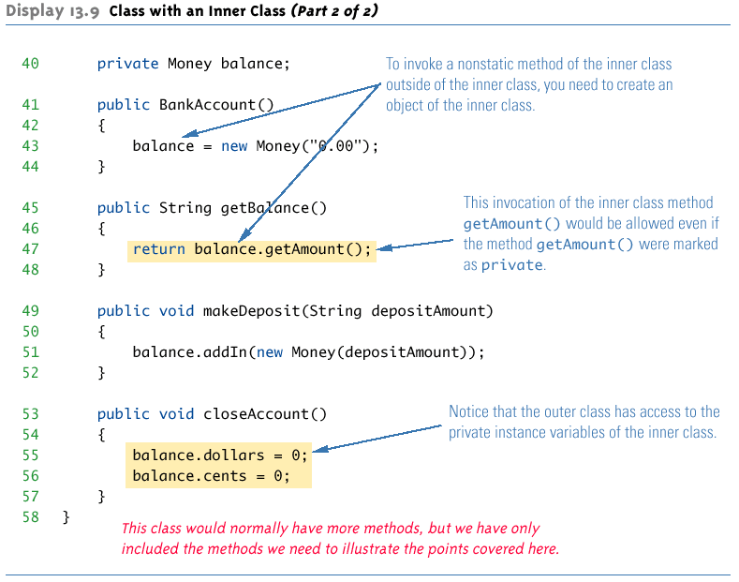
Class with an Inner Class

Slide 9
The .class File for an Inner Class
Compiling any class in Java produces a .class file named ClassName.class
Compiling a class with one (or more) inner classes causes both (or more) classes to be compiled, and produces two (or more) .class files
Such as ClassName.class and ClassName$InnerClassName.class

Slide 10
Static Inner Classes
A normal inner class has a connection between its objects and the outer class object that created the inner class object
This allows an inner class definition to reference an instance variable, or invoke a method of the outer class
There are certain situations, however, when an inner class must be static
If an object of the inner class is created within a static method of the outer class
If the inner class must have static members

Slide 11
Static Inner Classes
Since a static inner class has no connection to an object of the outer class, within an inner class method
Instance variables of the outer class cannot be referenced
Nonstatic methods of the outer class cannot be invoked
To invoke a static method or to name a static variable of a static inner class within the outer class, preface each with the name of the inner class and a dot

Slide 12
Public Inner Classes
If an inner class is marked public, then it can be used outside of the outer class
In the case of a nonstatic inner class, it must be created using an object of the outer class
BankAccount account = new BankAccount();
BankAccount.Money amount =
account.new Money("41.99");
Note that the prefix account. must come before new
The new object amount can now invoke methods from the inner class, but only from the inner class

Slide 13
Public Inner Classes
In the case of a static inner class, the procedure is similar to, but simpler than, that for nonstatic inner classes
OuterClass.InnerClass innerObject =
new OuterClass.InnerClass();
Note that all of the following are acceptable
innerObject.nonstaticMethod();
innerObject.staticMethod();
OuterClass.InnerClass.staticMethod();

Slide 14
Tip: Referring to a Method of the Outer Class
If a method is invoked in an inner class
If the inner class has no such method, then it is assumed to be an invocation of the method of that name in the outer class
If both the inner and outer class have a method with the same name, then it is assumed to be an invocation of the method in the inner class
If both the inner and outer class have a method with the same name, and the intent is to invoke the method in the outer class, then the following invocation must be used:
OuterClassName.this.methodName()

Slide 15
Nesting Inner Classes
It is legal to nest inner classes within inner classes
The rules are the same as before, but the names get longer
Given class A, which has public inner class B, which has public inner class C, then the following is valid:
A aObject = new A();
A.B bObject = aObject.new B();
A.B.C cObject = bObject.new C();

Slide 16
Inner Classes and Inheritance
Given an OuterClass that has an InnerClass
Any DerivedClass of OuterClass will automatically have InnerClass as an inner class
In this case, the DerivedClass cannot override the InnerClass
An outer class can be a derived class
An inner class can be a derived class also

Slide 17
Anonymous Classes
If an object is to be created, but there is no need to name the object's class, then an anonymous class definition can be used
The class definition is embedded inside the expression with the new operator
Anonymous classes are sometimes used when they are to be assigned to a variable of another type
The other type must be such that an object of the anonymous class is also an object of the other type
The other type is usually a Java interface

Slide 18
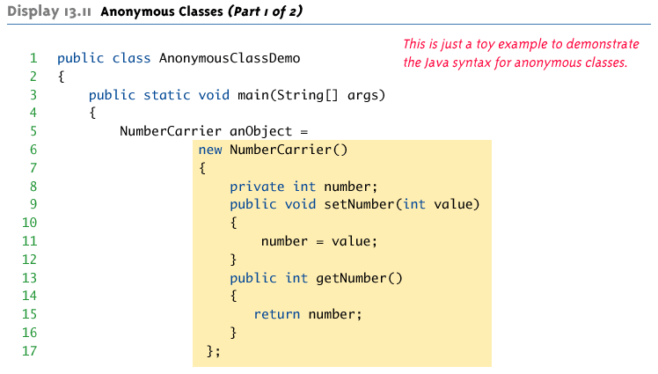
Anonymous Classes

Slide 19
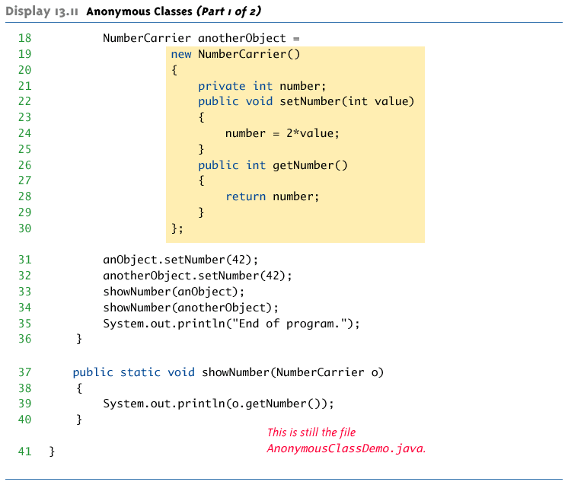
Anonymous Classes

Slide 20

Anonymous Classes

Slide 21
Method- local Inner Class
In Java, we can write a class within a method and this will be a local type.
Like local variables, the scope of the inner class is restricted within the method.
A method-local inner class can be instantiated only within the method where the inner class is defined.

Slide 22
Method- local Inner Class
public class Outerclass{
//instance method of the outer class
void my_Method(){
int num = 23;
//method-local inner class
class MethodInner_Demo{
public void print(){
System.out.println("This is method inner class "+num);
}
}//end of inner class
//Accessing the inner class
MethodInner_Demo inner = new MethodInner_Demo();
inner.print();
}
public static void main(String args[]){
Outerclass outer = new Outerclass();
outer.my_Method();
}
}

